Slide 1

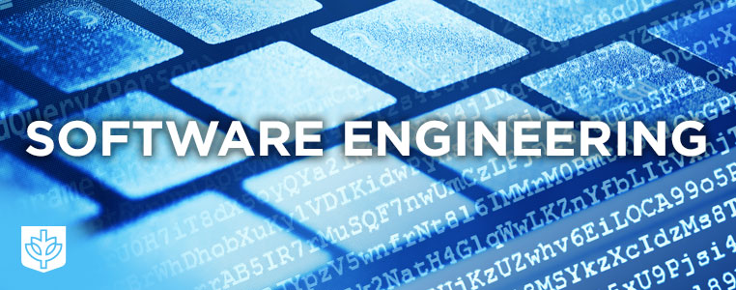
SE113
Lecture 3
Instructor:
Nusrat jahan
Lecturer, SWE, DIU.

Slide 2
Prototype
The prototype are usually not complete systems. This prototype is developed based on the currently known requirements.
the interactions with prototype can enable the client to better understand the requirements of the desired system.

Slide 3
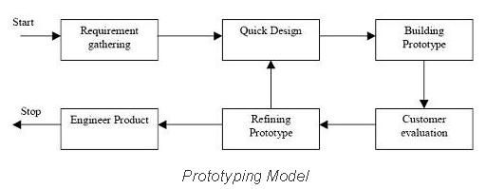
Prototyping Model

Slide 4
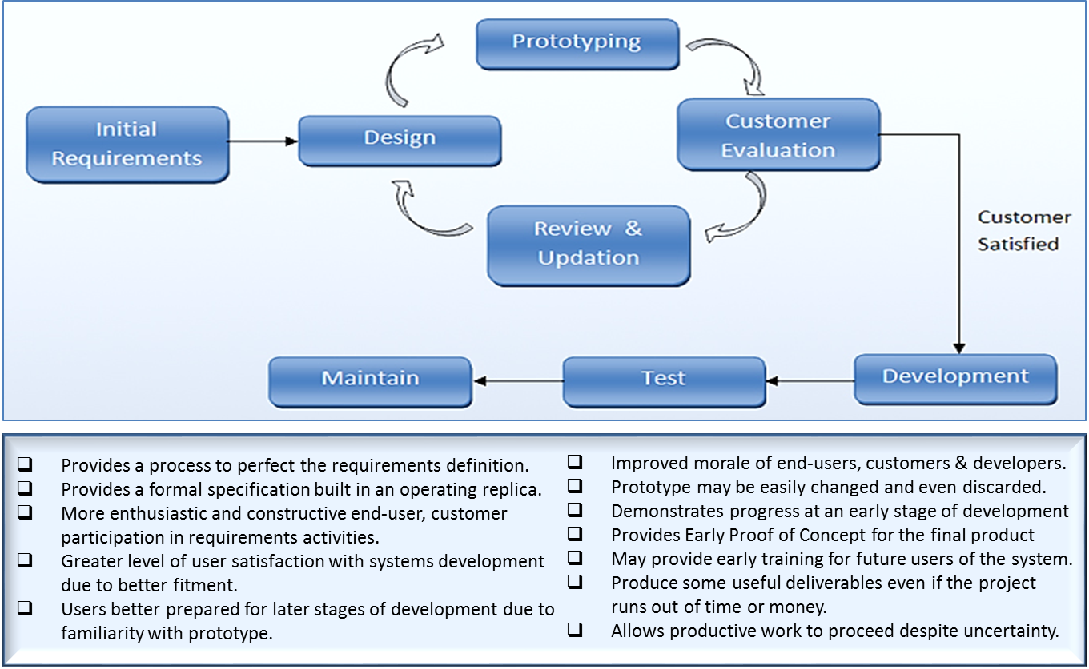
Prototyping Model

Slide 5
Advantages of Prototype model
Users are actively involved in the development
Since in this methodology a working model of the system is provided, the users get a better understanding of the system being developed.
Errors can be detected much earlier.
Quicker user feedback is available leading to better solutions.
Missing functionality can be identified easily
Confusing or difficult functions can be identified Requirements validation, Quick implementation of, incomplete, but functional, application.

Slide 6
Disadvantages of Prototype model:
Leads to implementing and then repairing way of building systems.
Practically, this methodology may increase the complexity of the system as scope of the system may expand beyond original plans.
Incomplete application may cause application not to be used as the full system was designed Incomplete or inadequate problem analysis.

Slide 7
When to use Prototype model
Prototype model should be used when the desired system needs to have a lot of interaction with the end users.
Typically, online systems, web interfaces have a very high amount of interaction with end users, are best suited for Prototype model. It might take a while for a system to be built that allows ease of use and needs minimal training for the end user.
Prototyping ensures that the end users constantly work with the system and provide a feedback which is incorporated in the prototype to result in a useable system. They are excellent for designing good human computer interface systems.

Slide 8
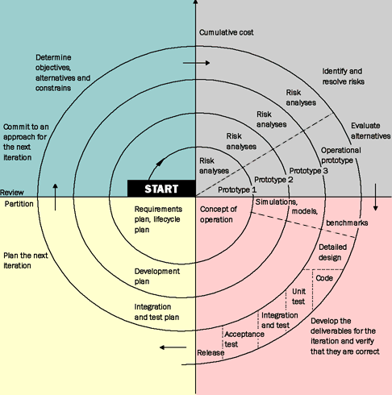
Spiral Development Model

Slide 9
Spiral Development Model—cont..
Each loop of a spiral model is split into four sectors:
Objectives setting.
Risk assessment and reduction
Development & Validation.
Planning

Slide 10
Advantages
There is explicit consideration of risk in this model.
Changing requirements can be accommodated.
Allows for extensive use of prototypes
Requirements can be captured more accurately.
Users see the system early.
Development can be divided into smaller parts and more risky parts can be developed earlier which helps better risk management.

Slide 11
Disadvantages
There is no fixed phase such as specification and design
Management is more complex.
End of project may not be known early.
Not suitable for small or low risk projects and could be expensive for small projects.
Process is complex
Spiral may go indefinitely.
Large number of intermediate stages requires excessive documentation.

Slide 12
When To Use
This model has been successfully used for the internal development of large systems and is especially useful when software reuse is a goal and when specific quality objectives can be incorporated
When costs and risk evaluation is important
Users are unsure of their needs
Requirements are complex
New product line
Significant changes are expected (research and exploration)

Slide 13
Agile Software Development
Agile software development is a conceptual framework for software engineering that promotes development iterations throughout the life-cycle of the project.
Software developed during one unit of time is referred to as an iteration, which may last from one to four weeks.
Agile methods also emphasize working software as the primary measure of progress.

Slide 14
Characteristics of Agile Software Development
Light Weighted methodology
Small to medium sized teams
vague and/or changing requirements
vague and/or changing techniques
Simple design
Minimal system into production

Slide 15
The Benefits of Being Agile
Reducing Risk – The benefits from improved control and improved communication lead to reduced risks. Examples of risks include:
Risk of building (or doing) the wrong thing. Did the sponsor get what they asked for but not what they actually wanted?
Risk of building the right thing poorly. For example, was the product poorly crafted. Was it thoroughly tested as a part of each iteration? Is the final produce extensible?
Risk of being placed into an endless cycle of design updates and reviews due to changing requirements or high levels of complexity

Slide 16
The Benefits of Being Agile
Relief from continual design revisions -- Agile Methods are of the most benefit when applied to projects where the requirements are either unclear or evolving

Slide 17
The Benefits of Being Agile
Improved Control – Agile methods allow the Project Manager to their control over the project in high change environment. Utilizing less rigid, yet structured agile methodologies, control is through a number of mechanisms.
Frequent delivery of working code allows progress to be objectively measured.
Early and frequent stakeholder feedback allows the Project Manager to redirect project priorities when needed to ensure that real value is delivered.
Misunderstandings are cleared up early in the project life-cycle.

Slide 18
Existing Agile Methods
Extreme Programming
Scrum
Crystal Methods
Feature Driven Development
Lean Development
Dynamic Systems Development Methodology (DSDM)

Slide 19
eXtreme Programming
A system of practices that a community of software developers is evolving to address the problems of quickly delivering quality software, and then evolving it to meet changing business needs.

Slide 20
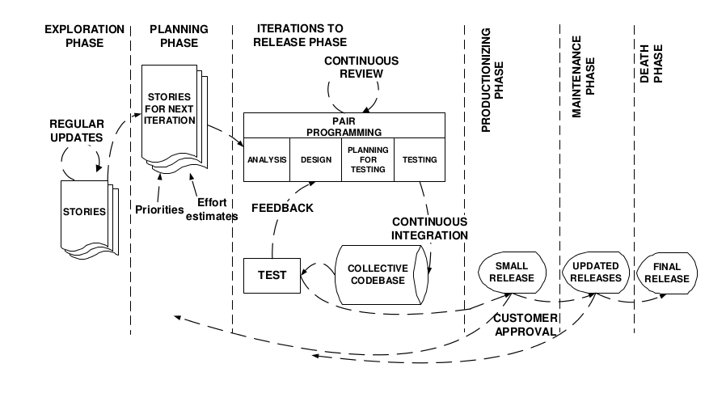
XP

Slide 21
Scrum - an agile process
SCRUM is an agile, lightweight process for managing and controlling software and product development in rapidly changing environments.
Iterative, incremental process
Team-based approach
developing systems/ products with rapidly changing requirements
Controls the chaos of conflicting interest and needs
Improve communication and maximize cooperation
Protecting the team form disruptions and impediments
A way to maximize productivity

Slide 22
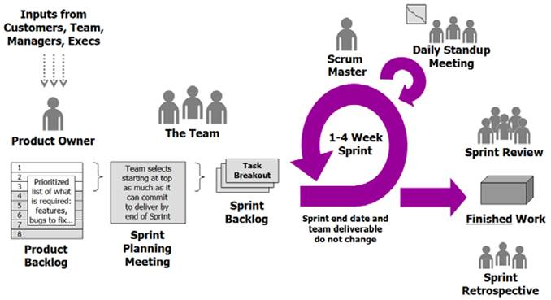
Functionality of Scrum

Slide 23
Thanks

